Slide 1
Simple SQL Queries

Slide 2
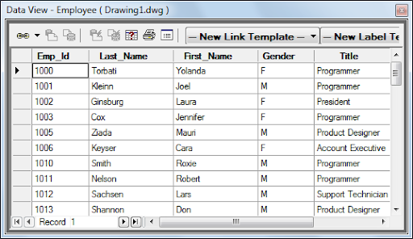
RECAP (9)
A _________ is composed of records and fields that hold data.
A ________ is a data structure for a single piece of data
A ________ is a grouping of fields within a table that reference one particular object
A _________ ____ is a field in a table which uniquely identifies each row/record in a database table (4)
The programming language use to make and manipulate databases is? (1)
Four types of commands that can be issued using this language (hint: CRUD) (4)

Slide 3
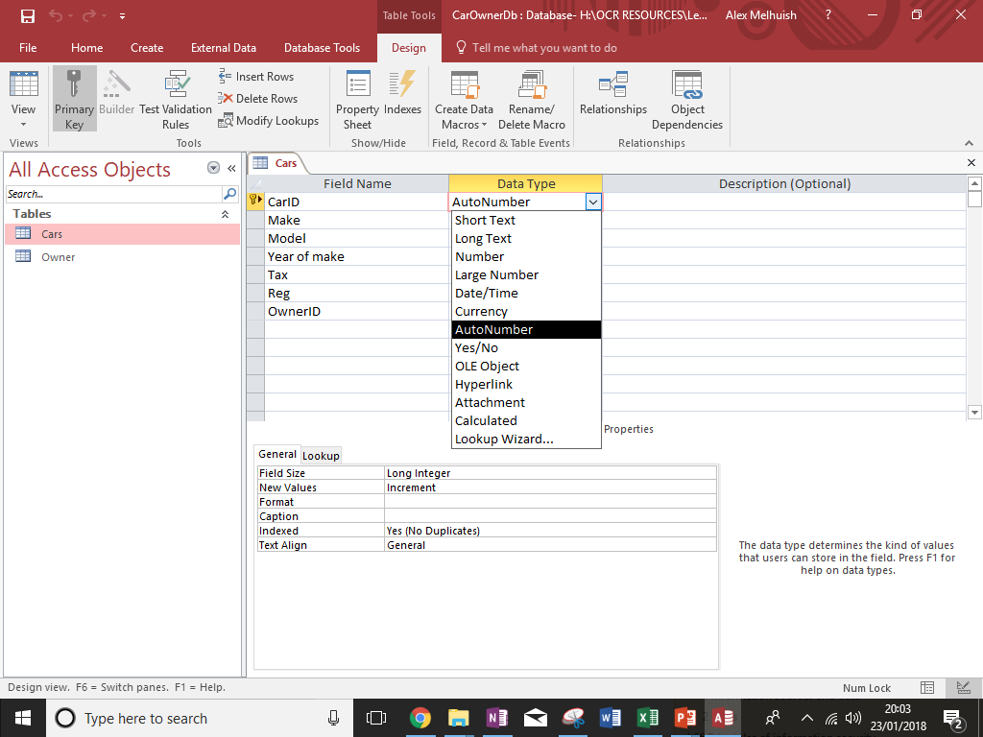

Slide 4
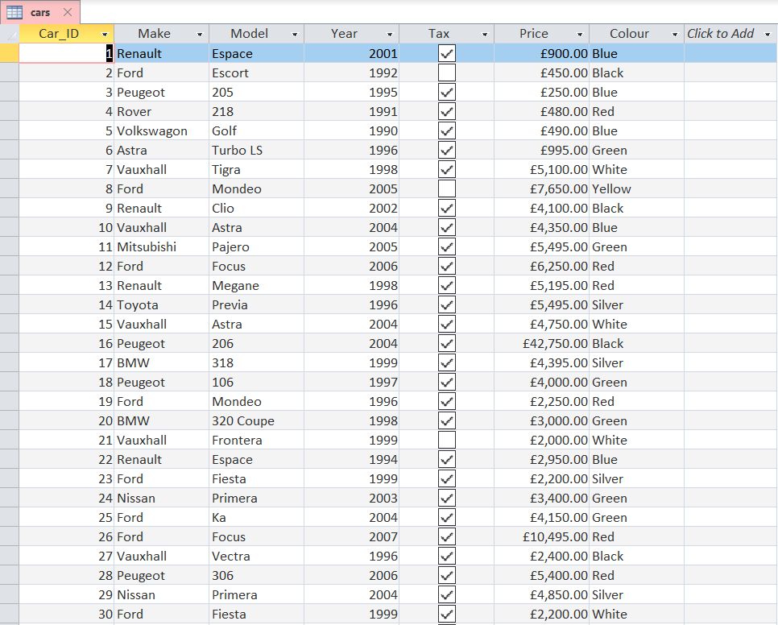

Slide 5
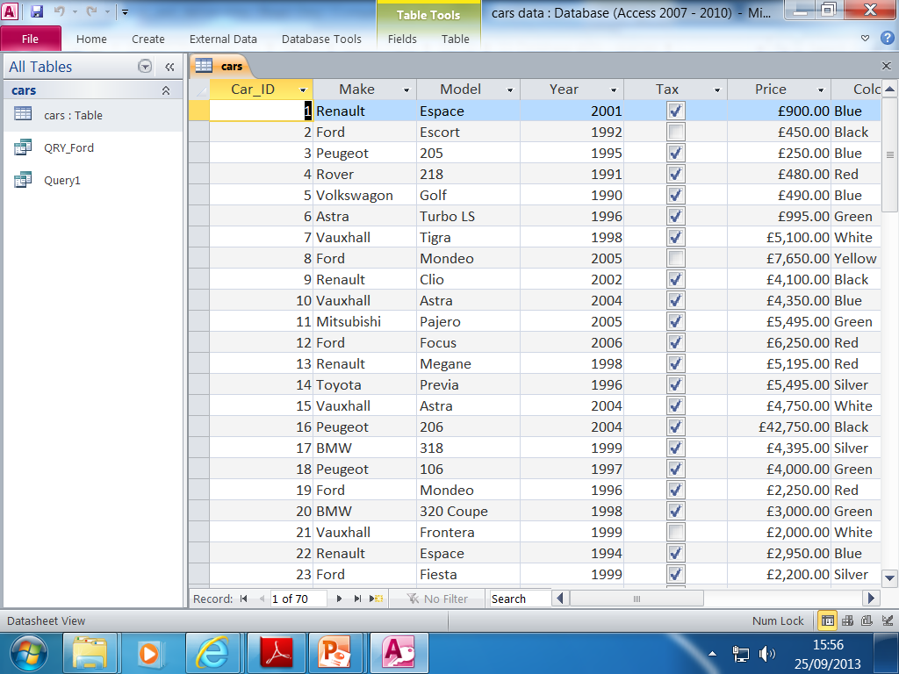
1) Tax =“Yes” 2) Year >=1996 3) Not “blue”
4) Model E*
5) Tax=“Yes” AND Year <=1991
6) Between [1991] AND [1994]
CONDITIONS
Notes:
What is a query?
Students to act as a query help in
5
2
4
2
2

Slide 6
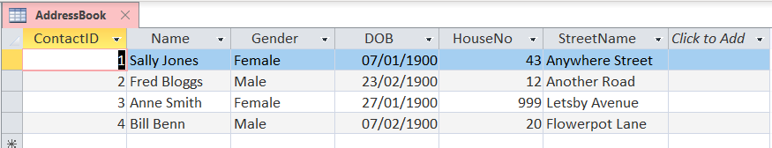
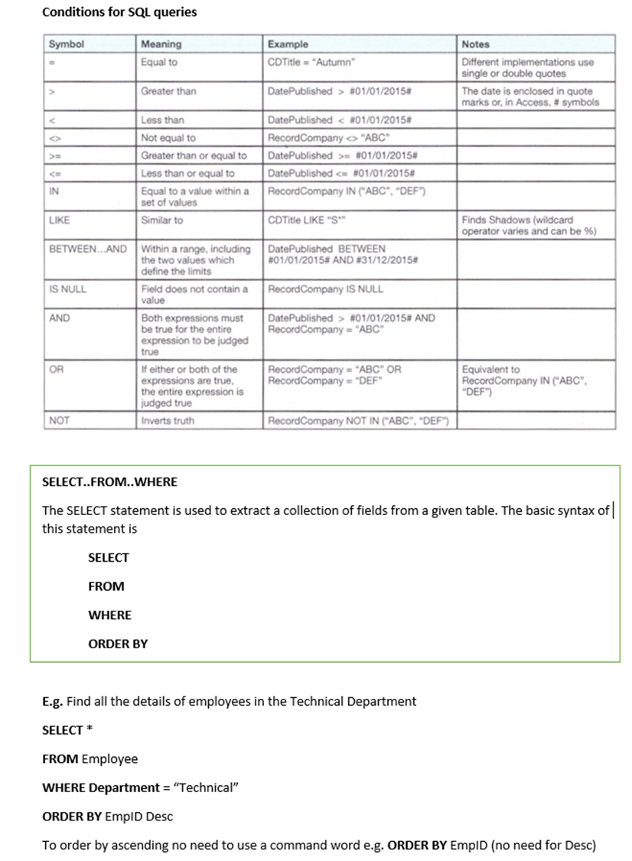
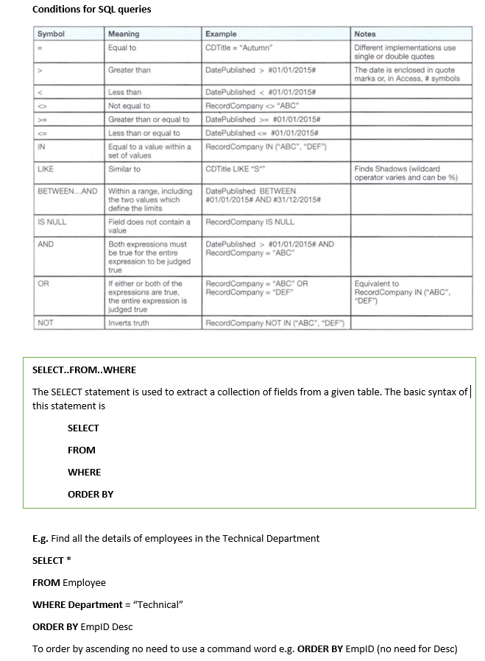
Query Operator Symbols
(=) – don’t need to use!
>=
>
<
<=
*
Not
BETWEEN X AND Y

Slide 7
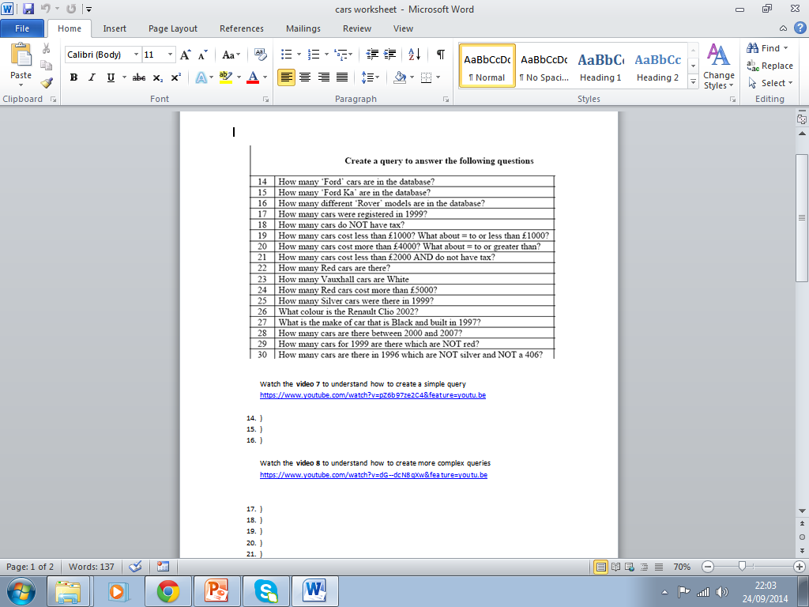
YOU MUST APPLY THE SKILL IN VIDEO 8 TO THE PROCEEDING QUESTIONS
Notes:
17
19
23
28
29

